Slide 1

Note: The data and information in this document is reflective of a hypothetical situation and client. This document is to be used for KPMG Virtual Internship purposes only.
Sprocket Central Pty Ltd
Data analytics approach
[Division Name] - [Engagement Manager], [Senior Consultant], [Junior Consultant]

Slide 2
Note: The data and information in this document is reflective of a hypothetical situation and client. This document is to be used for KPMG Virtual Internship purposes only.
Agenda
Introduction
Data Exploration
Model Development
Interpretation

Slide 3

Note: The data and information in this document is reflective of a hypothetical situation and client. This document is to be used for KPMG Virtual Internship purposes only.
Introduction
Welcome to the methodology and process walkthrough for the data exploration, model development and interpretation
Here, we will guide you through the various steps we will take building towards the analysis stage.
Place any supporting images, graphs, data or extra text here.

Slide 4
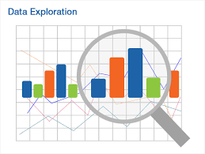
Note: The data and information in this document is reflective of a hypothetical situation and client. This document is to be used for KPMG Virtual Internship purposes only.
Data Exploration
This is the initial step of our data analysis process.
Here, we will review the data to uncover more data set characteristics and initial patterns. We will use a combination of statistical and visual techniques to aid us in getting the general outlook of the data. This step is important because it will shape our decisions in later stages of the data analysis process.
Place any supporting images, graphs, data or extra text here.

Slide 5
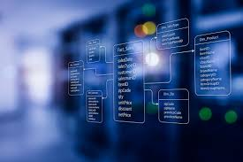
Note: The data and information in this document is reflective of a hypothetical situation and client. This document is to be used for KPMG Virtual Internship purposes only.
Model Development
This is the second step of the data analysis process.
This is an iterative process where we will use previously gathered information to come up with a model that fits the desired end goal of this process.
Place any supporting images, graphs, data or extra text here.

Slide 6

Note: The data and information in this document is reflective of a hypothetical situation and client. This document is to be used for KPMG Virtual Internship purposes only.
Interpretation
This is the final step of the data analysis process.
In this step, we will audit the proposed models and decompose the model’s predictions into components that can be attributed to various explanatory variables.
Place any supporting images, graphs, data or extra text here.

